Slide 1


Programming for Engineers
Lab class 4

Slide 2

Last week
Grouping data & Loop control structures
instruction1
 Arrays & Loops
 Functions
 Arithmetic operators
 Errors and debugging
No
?
Yes
instruction3
instruction2

Slide 3

Previously
We have covered all the basics by now
 Basic syntax
 Basic data types: int, float/double, char
 Variables, constants, and arrays
 Strings and escape characters
 Relational, logical, and arithmetic operators
 Control structures
 Conditional statements
 Loops
 Functions

Slide 4

Today
Problem-solving
 Intelligent Agents
 Symbol processing
 Problem-solving machines vs. humans
 Informal search example
 How to formalise a problem for search
 Uninformed search strategies
 BFS – Breadth-First Search
 DFS – Depth-First Search

Slide 5
Intelligent Agents
What are Intelligent Agents?
 Origin
Rational agents
Act rationally
Act like a human
Acting
Turing Test
Think like a human
Think rationally
Thinking
Cognitive Modelling
Within some paradigm:
Networks, programs, logic, etc.
Like a human
Just rationally

Slide 6

Intelligent Agents
What are Intelligent Agents?
 Origin
Rational agents
Act like a human
Act rationally
Acting
Turing Test
Think like a human
Think rationally
Thinking
Cognitive Modelling
Within some paradigm:
Networks, programs, logic, etc.
Like a human
Just rationally

Slide 7

Intelligent Agents
Properties of an agent
 There is a constrained task environment
 Means to interact with this environment
 Means to do something as a result
ENVIRONMENT
AGENT

Slide 8


Intelligent Agents
Properties of an agent
 There is a constrained task environment
 Means to interact with this environment
 Means to do something as a result
ENVIRONMENT
An agent has
 Sensors to perceive information from the environment
AGENT
perceive

Slide 9
Intelligent Agents
Properties of an agent
 There is a constrained task environment
 Means to interact with this environment
 Means to do something as a result
ENVIRONMENT
An agent has
 Sensors to perceive information from the environment
 Actuators to act upon the environment
AGENT
perceive
act

Slide 10
Intelligent Agents
“Agent” is a fairly general concept
 Human as an agent
 Sensors?
 Actuators?

Slide 11
Intelligent Agents
“Agent” is a fairly general concept
 Human as an agent
 Sensors: eyes, ears, skin, tongue, nose
 Actuators: muscles and body extremities
 Robot as an agent
 Sensors?
 Actuators?

Slide 12
Intelligent Agents
“Agent” is a fairly general concept
 Human as an agent
 Sensors: eyes, ears, skin, tongue, nose
 Actuators: muscles and body extremities
 Robot as an agent
 Sensors: it depends…
 Actuators: it depends…
There is no single model robot!
What is missing here?

Slide 13
Intelligent Agents
Properties of an agent
 There is a constrained task environment
 Means to interact with this environment
 Means to do something as a result
ENVIRONMENT
perceive
act
An agent has
 Sensors to perceive information from the environment
 Actuators to act upon the environment

Slide 14
Intelligent Agents
Properties of an agent
 There is a constrained task environment
 Means to interact with this environment
 Means to do something as a result
ENVIRONMENT
“be rational”
perceive
act
An agent has
 Sensors to perceive information from the environment
 Actuators to act upon the environment
 An Agent function to figure out what to do!

Slide 15
Intelligent Agents
Properties of an agent
 There is a constrained task environment
 Means to interact with this environment
 Means to do something as a result
ENVIRONMENT
“be rational”
perceive
act
An agent has
 Sensors to perceive information from the environment
 Actuators to act upon the environment
 An Agent function to figure out
what to do!
Implemented in a program

Slide 16
Intelligent Agents
How can an agent be rational?
 We need to tell the agent what is rational, i.e. it needs a performance measure
 The agent stores a percept sequence (information about environmental states)
 The agent may have some prior knowledge of the environment
 There are well-defined actions that can be performed by the agent
Definition of a rational agent
 For each possible percept sequence, a rational agent should select an action that is expected to maximise the performance measure, given the evidence provided by the percept sequence and whatever built-in knowledge the agent has.
(Russel & Norvig, 2nd ed., pg. 36)

Slide 17

Intelligent Agents
An Automatic Vacuum Cleaner
 Percept sequence {roomLabel, roomState}, {…}
 Valid actions {goLeft, goRight, cleanUp, noOp}
A
B
1
2

Slide 18
Intelligent Agents
An Automatic Vacuum Cleaner
 Percept sequence {roomLabel, roomState}, {…}
 Valid actions {goLeft, goRight, cleanUp, noOp}
Percept Seq | Action
{A, clean} | goRight
{A, dirty} | cleanUp
{B, clean} | goLeft
{B, dirty} | cleanUp
{A, clean}, {B, clean} | goLeft
{A, dirty}, {A, clean} | goRight
… | …
A
B
1
2

Slide 19
Intelligent Agents
An Automatic Vacuum Cleaner
 Percept sequence {roomLabel, roomState}, {…}
 Valid actions {goLeft, goRight, cleanUp, noOp}
 Performance measure: Maximise clean-percepts
Percept Seq | Action
{A, clean} | goRight
{A, dirty} | cleanUp
{B, clean} | goLeft
{B, dirty} | cleanUp
{A, clean}, {B, clean} | goLeft
{A, dirty}, {A, clean} | goRight
… | …
A
B
1
Is this agent rational?
2

Slide 20
Intelligent Agents
An Automatic Vacuum Cleaner
 Percept sequence {roomLabel, roomState}, {…}
 Valid actions {goLeft, goRight, cleanUp, noOp}
 Performance measure: Maximise clean-percepts
Percept Seq | Action
{A, clean} | goRight
{A, dirty} | cleanUp
{B, clean} | goLeft
{B, dirty} | cleanUp
{A, clean}, {B, clean} | goLeft
{A, dirty}, {A, clean} | goRight
… | …
A
B
1
Is this agent rational?
2
Depends on what has been defined as rational ➔ task environment

Slide 21
Intelligent Agents
An Automatic Vacuum Cleaner
 Percept sequence {roomLabel, roomState}, {…}
 Valid actions {goLeft, goRight, cleanUp, noOp}
 Performance measure with limited lifetime: Maximise clean-percepts, limit movement
Percept Seq | Action
{A, clean} | goRight
{A, dirty} | cleanUp
{B, clean} | goLeft
{B, dirty} | cleanUp
{A, clean}, {B, clean} | goLeft
{A, dirty}, {A, clean} | goRight
… | …
A
B
1
Is this agent rational?
2
Depends on what has been defined as rational ➔ task environment

Slide 22
Intelligent Agents
Types of Agents
 Simple Reflex Agent
 Simple reactive dynamic
 Selects action based on current percept
ENVIRONMENT
“be rational”
Rules
Input
Rule Action
Input
perceive
act
Action

Slide 23
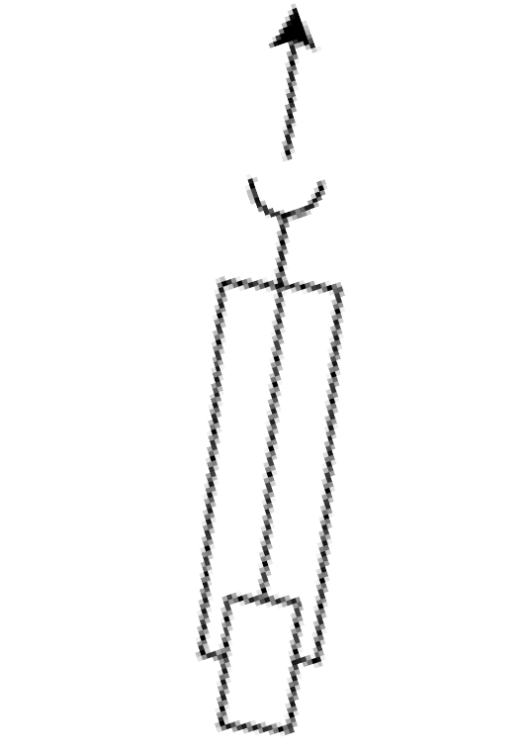
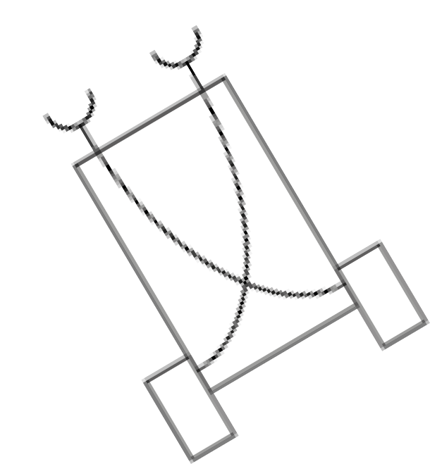
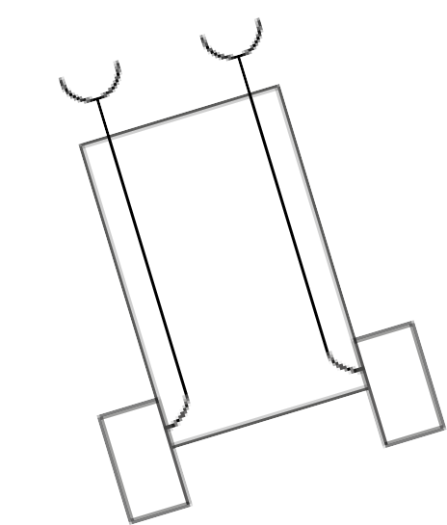
Intelligent Agents
Types of Agents
 Simple Reflex Agent
 e.g., Braitenberg vehicles:
“We will talk about machines with very simple internal structure ... when we look at these
machines or vehicles as if they were animals in a natural environment ... we will be tempted, then, to use psychological language in describing their behavior. And yet we know very well that there is nothing in these vehicles that we have not put in ourselves.” (Braitenberg, 1984)
Simple reactive dynamic
Variation in patterns and type of
of sensory-motor connection
produces widely diverging behaviors
Fear
Approach
Aggression

Slide 24
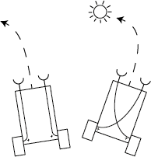
Intelligent Agents
Types of Agents
 Simple Reflex Agent
 Braitenberg illustrates the potential for over-blown, anthropomorphic interpretation:
“Let Vehicles 2a and 2b move around in their world for a while and watch them. Their characters are quite opposite. Both DISLIKE sources. But 2a becomes restless in their vicinity and tends to avoid them, escaping until it safely reaches a place where the influence of
the source is scarcely felt. Vehicle 2a is a COWARD, you would say.
Not so Vehicle 2b. It, too, is excited by the presence of sources, but resolutely turns toward them and hits them with high velocity, as if it wanted to destroy them. Vehicle 2b is AGGRESSIVE, obviously.”
2a
2b

Slide 25

Intelligent Agents
Types of Agents
 Model-based Reflex Agent
 Stores facts and/or procedural knowledge
about the world in a model
 Updates internal states
ENVIRONMENT
“be rational”
3x
State Model
updates
Input
perceive
select
act
Rules
Action

Slide 26
Intelligent Agents
Types of Agents
 Goal-based Agent
 Model-based agent that can
determine preference
 Binary goal (happy / unhappy state)
ENVIRONMENT
“be rational”
perceive
 | x | x | updates State Input Model Predictions Goals Action
 | x | x
 |  | o
act

Slide 27
Intelligent Agents
Types of Agents
 Utility-based Agent
 More specific performance measure
 Allows effective heuristics to be used
ENVIRONMENT
“be rational”
perceive
o | 1 |  | updates State Input Model Predictions Utility Action
2 | 1
act

Slide 28

Problem-solving
How does it work?
 Humans: High-level cognitive process that involves knowledge and reasoning
 Knowledge can be expressed using physical symbol systems
(e.g., logic, mathematics, natural language, diagrams, Egyptian hieroglyphs, etc.)
 Problem-solving often involves the manipulation of these symbols
1 + 1 = 2
I think, therefore I am.
010001000110111010010

Slide 29
Problem-solving
Problem-solving: Machines vs. Humans
Example: Consider the following problem
Our universe consists of 9 rooms {A1,noBall}, {C2,hasBall}, {B1,noBall}, {C1,noBall},
{B3,noBall}, {A2,noBall}, {B2,noBall}, {A3,noBall}, {C3,noBall}
Neighbouring rooms have alphabetic labels from left (A) to right (C) Rooms on different levels have numeric labels from bottom (1) to top (3) Valid actions are goLeft, goRight, goUp, goDown
Your are currently in room A3
?

Slide 30
Problem-solving
Problem-solving: Machines vs. Humans
Example: Consider the following problem
Our universe consists of 9 rooms {A1,noBall}, {C2,hasBall}, {B1,noBall}, {C1,noBall},
{B3,noBall}, {A2,noBall}, {B2,noBall}, {A3,noBall}, {C3,noBall}
Neighbouring rooms have alphabetic labels from left (A) to right (C) Rooms on different levels have numeric labels from bottom (1) to top (3) Valid actions are goLeft, goRight, goUp, goDown
Your are currently in room A3
?
How many shortest routes are there from your current room to the room with the ball, given the valid moves, and given that we do not want to visit any room twice?

Slide 31
Problem-solving
Problem-solving: Machines vs. Humans
Example: Consider the following problem
YOU HAVE 10 SECONDS TO FIGURE IT OUT
Our universe consists of 9 rooms {A1,noBall}, {C2,hasBall}, {B1,noBall}, {C1,noBall},
{B3,noBall}, {A2,noBall}, {B2,noBall}, {A3,noBall}, {C3,noBall}
Neighbouring rooms have alphabetic labels from left (A) to right (C) Rooms on different levels have numeric labels from bottom (1) to top (3) Valid actions are goLeft, goRight, goUp, goDown
Your are currently in room A3
?
How many shortest routes are there from your current room to the room with the ball, given the valid moves, and given that we do not want to visit any room twice?

Slide 32
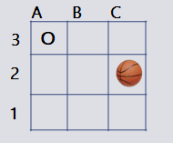
Problem-solving
Problem-solving: Machines vs. Humans
 Sub-problems to tackle:

Slide 33
Problem-solving
Problem-solving: Machines vs. Humans
 Sub-problems to tackle:
Where am I?
Which rooms are next to where I currently am?
Where can I go from these rooms?
Have I been there before?
How many steps have I taken so far?
…

Slide 34
Problem-solving
Problem-solving: Machines vs. Humans
 Sub-problems to tackle:
Where am I?
Which rooms are next to where I currently am?
Where can I go from these rooms?
Have I been there before?
How many steps have I taken so far?
…
 We require memory to remember the elements of any partial solutions

Slide 35
Problem-solving
Problem-solving: Machines vs. Humans
 Sub-problems to tackle:
Where am I?
Which rooms are next to where I currently am?
Where can I go from these rooms?
Have I been there before?
How many steps have I taken so far?
…
 We require memory to remember the elements of any partial solutions
 In symbol-processing, the way in which the knowledge is represented can have a
dramatic impact on the efficiency of the reasoning process

Slide 36
Problem-solving
Problem-solving: Machines vs. Humans
 For example, well-designed diagrams are a kind of representation that is very
intuitive and effective for humans to reason with
A B C
Visual problem perception
3
2
o
Visual-spatial reasoning
Memory off-loading, with or without manipulating the external representation
1

Slide 37
Problem-solving
Problem-solving with computer programs
 We can use data structures (variables, arrays…) to represent problem-solving
knowledge and store partial solutions
We can use expressions, control structures (conditionals, loops) and other syntax to implement a formal mechanism that
 Identifies ways in which possible actions can be arranged into sequences
 Finds a particular sequence of actions which achieves a desired result
 This way, a computer program can SEARCH for a solution

Slide 38

Problem-solving
A B C
How does a computer (or robot) search?
3
o
2
1
 We start from an initial state and look for a goal state
 From the current state, we run a function that determines its successive states
 We travel to the successors and perform a goal test before expanding them further
If we found a state that is the goal, we backtrack to the start to establish the path that
presents a solution
 We keep track of states that we discovered and that are waiting to get expanded
We also keep track of any states already expanded along the current path (the
prospective solution)

Slide 39

Problem-solving
Problem-solving with computer programs
A B C
3
o
Initial state:
Goal state:
(inA3, noBall)
(inXy, hasBall)
2
Universal knowledge view
1
Valid successors
Travel on same floor:
Ay->By, By->Ay, By->Cy, Cy->By
Exit
Exit
Travel to different floor:
X1->X2, X2->X1, X2->X3, X3->X2
Robot agent view
current room

Slide 40

Problem-solving
Problem-solving with computer programs
States expanded : 0
States waiting : 0
Initial state (inA3, noBall)
A B C
A3
3
2
o
1
A3

Slide 41
Problem-solving
Problem-solving with computer programs
States expanded : 1
States waiting : 2
Discover successive states
A B C
A3
A2
o o
B3
A2
B3
3
2
o
1
A3

Slide 42

Problem-solving
Problem-solving with computer programs
States expanded : 2
States waiting : 3
A3
A2 B3
Do goal test:
If (inA2, noBall) != (inXy, hasBall), discover its successive states
A B C
B2
A1
o o
3
2
A1
B2
o
o
o
A2
1

Slide 43

Problem-solving
Problem-solving with computer programs
States expanded : 3
States waiting : 3
Breadth-first search: Go back and complete exploring this depth level!
A3
A B C
C3
B2
o o
o
A2
B3
3
2
A1
B2
C3
o
o
o
B3
1

Slide 44

Problem-solving
Problem-solving with computer programs
States expanded : 4 States waiting : 3
A3
A B C
B1
3
2
o
o o
A2
B3
A1
B2
C3
o
o
B1
o
o
1
A1

Slide 45

Problem-solving
Problem-solving with computer programs
States expanded : 5 States waiting : 6
A3
A B C
B3
C2
B1
o
o
o
A2
B3
3
2
A1
B2
C3
o
o
o
B1
C2
o
o
1
B2

Slide 46
Problem-solving
Problem-solving with computer programs
States expanded : 5
States waiting : 5
A3
A2 B3
We have already visited B2 earlier and it’s not the goal
A B C
C3
B2
o o
o
3
2
A1
B2
C3
o
o
o
B1
C2
o
o
1
B3

Slide 47


Problem-solving
Problem-solving with computer programs
States expanded : 6 States waiting : 5
A3
A B C
C2
o
o
o
A2
B3
3
2
A1
B2
C3
o
o
o
B1
C2
o
o
1
C3

Slide 48

Problem-solving
Problem-solving with computer programs
States expanded : 7 States waiting : 6
A3
A B C
B2
C1
o
o
o
A2
B3
3
2
A1
B2
C3
o
o
o
B1
C2
o
o
o
1
B1
C1

Slide 49

Problem-solving
Problem-solving with computer programs
States expanded : 7
States waiting : 5
A3
We have already visited B1 earlier and it’s not the goal
A B C
B2
C2
B1
o o
o
A2
B3
3
2
A1
B2
C3
o
o
o
B1
C2
o
o
o
1
B2
C1

Slide 50

Problem-solving
Problem-solving with computer programs
States expanded : 7 States waiting : 4
A3
A B C
o
o
o
A2
B3
3
2
A1
B2
C3
o
o
o
B1
C2
o
o
o
1
C2
C1

Slide 51
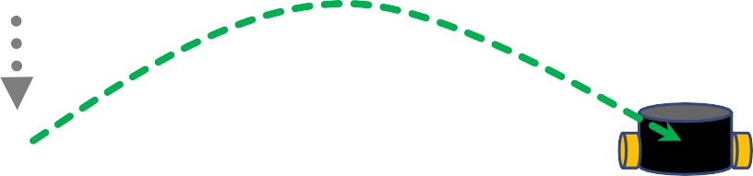
Problem-solving
Problem-solving with computer programs
States expanded : 7
States waiting : 4
Reconstruct the path to the root node by asking each node for its parent node until there is no parent left.
A3
A B C
3
2
o
o
o
A2
B3
A1
B2
C3
o
o
o
B1
C2
o
o
o
1
C1

Slide 52

Formalising a problem for search
How to formalise a problem for search
1. Determine the relevant problem-solving knowledge

Slide 53
Formalising a problem for search
How to formalise a problem for search
Determine the relevant problem-solving knowledge
Find a suitable state representation

Slide 54
Formalising a problem for search
How to formalise a problem for search
Determine the relevant problem-solving knowledge
Find a suitable state representation
Define the initial state and the goal state(s)

Slide 55
Formalising a problem for search
How to formalise a problem for search
Determine the relevant problem-solving knowledge
Find a suitable state representation
Define the initial state and the goal state(s)
Define a transition model (also called successor function)

Slide 56
Formalising a problem for search
How to formalise a problem for search
Determine the relevant problem-solving knowledge
Find a suitable state representation
Define the initial state and the goal state(s)
Define a transition model (also called successor function)
Now, a machine can do the search

Slide 57

Implementing search
How to search
 Starting from the initial state, apply the successor function to reveal successor states
 Generate a search tree by expanding these states, and discovering their respective
successors, etc.
 Perform a goal test for every node expanded
Keep track of nodes waiting to get expanded (open list), and nodes already
expanded along the current path (the prospective solution).
In so-called “graph search”, we also keep a separate record of nodes already
visited.

Slide 58

Briefly: Tree vs. Graph Search
A B C
Tree Search
 Maintains a list of nodes that are expanded +
3
2
o
1
a list of nodes at the fringe of currently expanded nodes
A3
 Different search strategies will “open”
the nodes at the fringe in a particular order
 Nodes representing the same state can be visited more than once
 A tree is a specific kind of graph with certain
computational properties
A2
B3
A1
B2
B2
C3
B1
B1
C2
B1
C2
C2
B2
C1
C1
C2
C2
C2

Slide 59
Briefly: Tree vs. Graph Search
A B C
Graph Search
 Maintains a list of nodes that are expanded +
3
2
o
1
a list of nodes at the fringe of currently expanded nodes +
a list of nodes that have already been visited
A3
A2
B3
This help avoid redundancy as nodes will not be visited over and over again in cycles
C3
A1
B2
B1
C2
C1

Slide 60

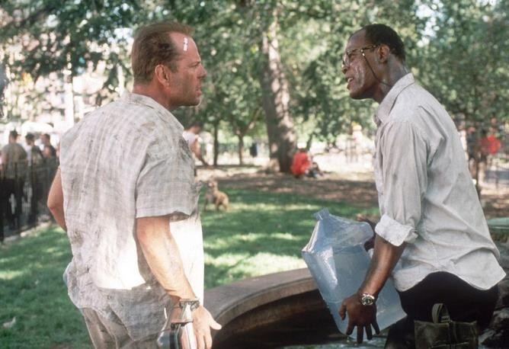
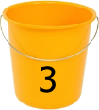
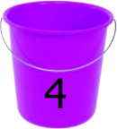
Basic Search Components
Example
There are two empty buckets and an unlimited supply of water. One bucket can hold 3 litres, the other one 4 litres.
We need a quantity of exactly 2 litres of water (all in one go, in either of the buckets)
2 litres ?
Picture: diehard.wikia.com

Slide 61
Basic Search Components
Example
 State representation
 Initial state
 Goal state(s)
 Successor function
 Goal test

Slide 62
Basic Search Components
Example
 State representation
 Initial state
 Goal state(s)
 Successor function
 Goal test
( a , b )

Slide 63
Basic Search Components
Example
 State representation
 Initial state
 Goal state(s)
 Successor function
 Goal test
( a , b )
( 0 , 0 )

Slide 64
Basic Search Components
Example
 State representation
 Initial state
 Goal state(s)
 Successor function
 Goal test
( a , b )
( 0 , 0 )
( 2 , x ) ; ( y , 2 )

Slide 65
Basic Search Components
Example
 State representation
 Initial state
 Goal state(s)
 Successor function
( a , b )
( 0 , 0 )
( 2 , x ) ; ( y , 2 )
fill( a ), fill( b )
empty( a ), empty( b ) pour( a, b ), pour( b, a )
 Goal test

Slide 66
Basic Search Components
Example
 State representation
 Initial state
 Goal state(s)
 Successor function
( a , b )
( 0 , 0 )
( 2 , x ) ; ( y , 2 )
fill( a ), fill( b )
empty( a ), empty( b ) pour( a, b ), pour( b, a )
equality between current state and goal state(s)
 Goal test

Slide 67

Defining custom data types
typedef struct
Declaration
 Allows grouping several data types into one single structure
 Assigns an alias with which we can refer to the data type
Initialisation
typedef struct { int a;
int b;
} ordered_pair;
typedef struct {
data_type identifier; data_type identifier;
...
} alias_name;
Access member data
...
ordered_pair x = {1,2};
int i = x.a; int k = x.b;

Slide 68

Practice time
Solve the water gauging problem – without a computer
Try to solve the problem without a computer by manually drawing the search tree
(max. 10 minutes)
Then, create a program that has
A suitable data structure for the state representation
An initial state and a goal state
A successor function with suitable operations mapping the different actions
A function for the goal test

Slide 69

Implementing Search Algorithms
Abstract data types (ADT)
 Search requires some book-keeping
 Some of this can be done with arrays – e.g., to keep a list of the nodes
waiting to be expanded
 How do we know which elements to put on and off this list, and in which order?

Slide 70
Implementing Search Algorithms
Abstract data types (ADT)
 Search requires some book-keeping
 Some of this can be done with arrays – e.g., to keep a list of the nodes
waiting to be expanded
 How do we know which elements to put on and off this list, and in which order?
This is determined by our search strategy!

Slide 71
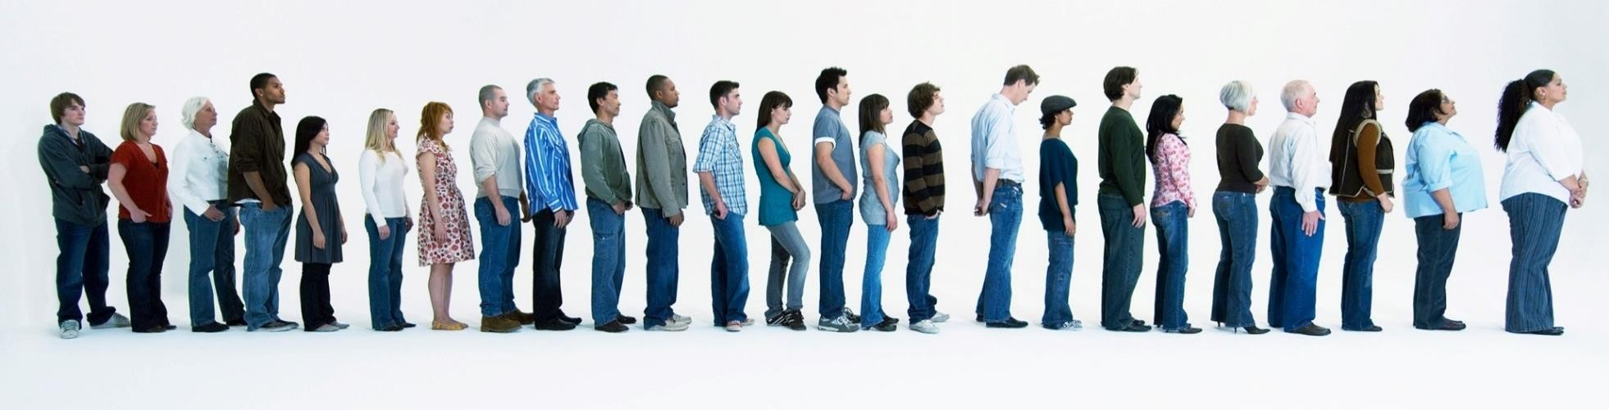
Implementing Search Algorithms
Breadth-First Search
 General principle: First-In First-Out
 Corresponding ADT: (FIFO) Queue
IN
OUT
Picture: theguardian.com

Slide 72
Implementing Search Algorithms
General List Management
Waiting
Explored

Slide 73
Implementing Search Algorithms
General List Management
“Open” list (sufficient for Tree Search)
knows
Waiting
knows
Explored

Slide 74
Implementing Search Algorithms
General List Management
“Open” list (sufficient for Tree Search)
knows
Waiting
knows
Explored
“Visited” list (Graph Search)

Slide 75
Implementing Search Algorithms
Breadth-First Search
Initial State
FRONT
Waiting
Explored

Slide 76
Implementing Search Algorithms
Breadth-First Search
Expand node
FRONT Waiting
Explored

Slide 77
Implementing Search Algorithms
Breadth-First Search
Discover fringe
FRONT
Waiting
Explored

Slide 78
Implementing Search Algorithms
Breadth-First Search
Nodes in queue
FRONT
Waiting
Explored

Slide 79

Implementing Search Algorithms
Breadth-First Search
First-in First-out!
Expand node
FRONT
Waiting
Explored

Slide 80
Implementing Search Algorithms
Breadth-First Search
Discover fringe
FRONT
Waiting
Explored

Slide 81
Implementing Search Algorithms
Breadth-First Search
Nodes in queue
FRONT
Waiting
Explored

Slide 82
Implementing Search Algorithms
Breadth-First Search
Expand node
FRONT
Waiting
Explored
and so on…

Slide 83
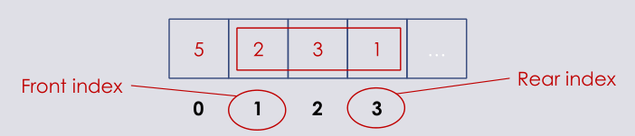
How to use an array to make a queue
Is there a “queue” variable data type?
Queues do not exist as native data types in C
We can make an array behave like a queue
We can use variables to remember the front and rear indices of the data in an array
If we add something to the array ,we increase “rear”
If we read an element, we increase “front”

Slide 84
Practice time
Solve the water gauging problem
Create a program that has
A suitable data structure for the state representation
An initial state and a goal state
A successor function with suitable operations mapping the different actions
A function for the goal test
A function that performs Breadth-First Search

Slide 85
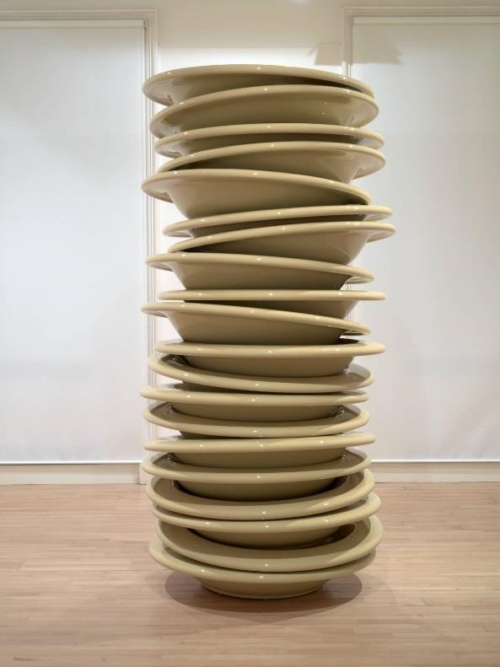
Implementing Search Algorithms
Depth-First Search
IN OUT
 General principle: Last-In First-Out
 Corresponding ADT: Stack
(LIFO Queue)
Picture: tate.org.uk

Slide 86

Implementing Search Algorithms
Depth-First Search
Initial State
FRONT
Waiting
Explored

Slide 87
Implementing Search Algorithms
Depth-First Search
Expand node
FRONT Waiting
Explored

Slide 88
Implementing Search Algorithms
Depth-First Search
Discover fringe
FRONT
Waiting
Explored

Slide 89
Implementing Search Algorithms
Depth-First Search
Nodes in stack
FRONT
Waiting
Explored

Slide 90
Implementing Search Algorithms
Depth-First Search
Last-in First-out!
Expand node
FRONT
Waiting
Explored

Slide 91
Implementing Search Algorithms
Depth-First Search
Discover fringe
FRONT
Waiting
Explored

Slide 92
Implementing Search Algorithms
Depth-First Search
Nodes in stack
FRONT
Waiting
Explored

Slide 93

Implementing Search Algorithms
Depth-First Search
Expand node
FRONT
Waiting
Explored
and so on…

Slide 94
Practice time
Create a program in C that can solve the water gauging problem
Create a program that has
A suitable data structure for the state representation
An initial state and a goal state
A successor function with suitable operations mapping the different actions
A function for the goal test
A function that performs Breadth-First Search
A function that performs Depth-First Search (optional)

Slide 95

Homework
Reflection on the implementation of search
Different implementations of search algorithms tend to share the same basic
Components
However, they may behave differently, depending on how we specify these components in detail, and in which order we execute them.
For instance, we may stop search after a solution has been found, or continue searching exhaustively.
Another example would be how behaviour changes depending on
our implementation of the search strategy (how we implement WAITING).
whether we use tree search or graph search (if/how we implement VISITED).

Slide 96
Homework
Task
 Experiment with our previous implementations of BFS and DFS (graph-) search.
 Do the following and observe the resulting changes in search behaviour:
Manipulate the order of the main search instructions
(e.g., put a state on the visited list after the goal test, and after running the successor function; or, change the location in the code where membership of that list is checked).
Transform the previous programs into tree-search (no visited list, but duplicates within the current path are checked).
Change the order of how different states are generated in the successor function.

Slide 97

Read
Russel and Norvig, Chapter 2 & 3.
Optional readings
 Problem Solving.
Kevin Dunbar, 1998
Blackwell
Human problem solving.
Newell & Simon, 1972
Prentice Hall
Vehicles : experiments in synthetic psychology
Valentino. Braitenberg
Cambridge, Mass. : MIT Press 1984

Slide 98

Next Lab
 Pointers
 File I/O
 Passing parameters to programs
 Memory management

